Slide 1
Making Repositories RESTful

Slide 2

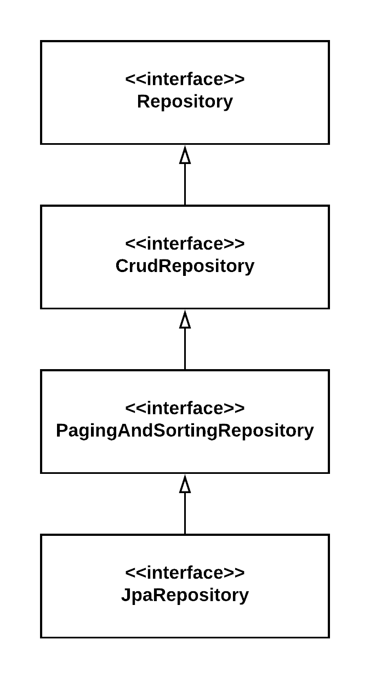


Enhancing the Spring Data Repository
Level 2 & 3 REST HAL - ALPS
JSON
Spring Data
Spring MVC
RestController
to UI
Spring Data JPA
SpeakerJpaRepository
speakers

Slide 3






Understanding REST API URLs
SpeakerJpaRepository
Speaker
URL Pattern: Example:
http(s)://server:port/basePath/resource https://localhost:8080/api/speakers
@RepositoryRestResource(path = "authors")
public interface SpeakerJpaRepository extends JpaRepository<Speaker, Long> {
...
}
Example:
https://localhost:8080/api/authors

Slide 4

Spring Data REST Level 2 Resources
https://localhost:8080/api/speakers
Hypermedia HATEOAS
3
HTTP
Verb
URL
Backing Method
GET
POST GET
PUT PATCH DELETE
/api/speakers
/api/speakers
/api/speakers/{id}
/api/speakers/{id}
/api/speakers/{id}
/api/speakers/{id}
findAll(…)
save(…) getOne(…)
save(…) save(…) delete(…)
2 - Verbs
1 - Resources
0 - RPC Services

Slide 5
Summary
REST and Spring Data repositories Collection resources
Item resources Association resources Customizing services

